Slide 1

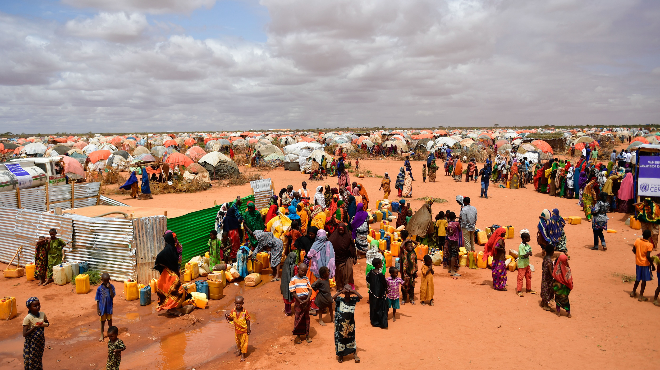



CLIMATE AND CONFLICT IN SOMALIA
Sara Ghivarello

Slide 2

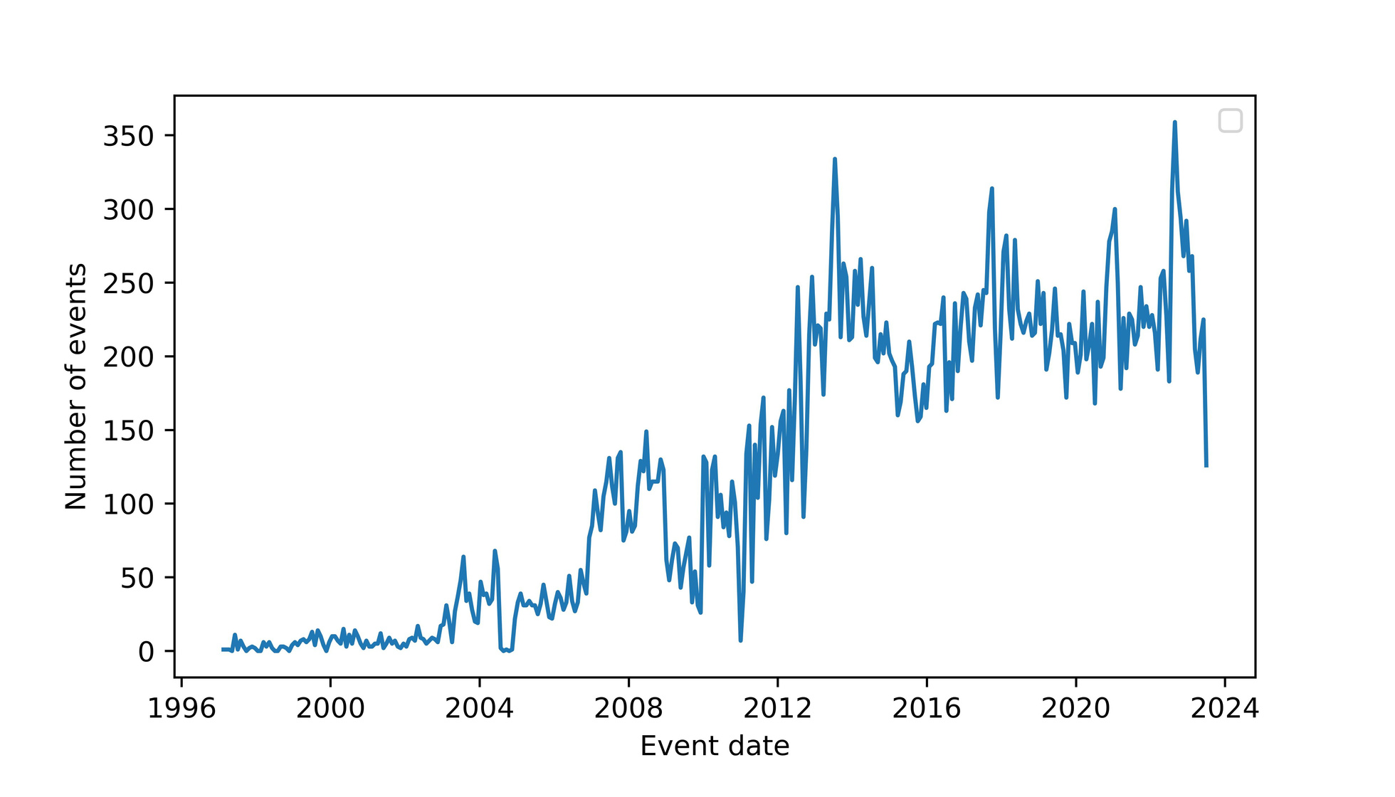
PROTESTS AND VIOLENT EVENTS

Slide 3






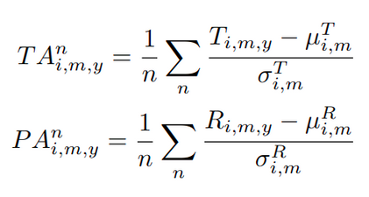
DATA
Climate
Conflicts
Displacements
Control
Timeseries dataset of gridded temperature and precipitation
Protests and violent events at a sub-national level, grouped per month
Protection and Return Monitoring Network (PRMN) survey
GDP and population density

Slide 4
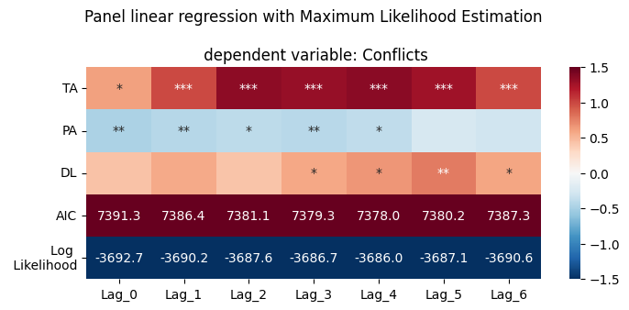
LINEAR MODEL 1a
Temperature anomalies TA
Precipitation anomalies PA
Drought lenght DL
Conflicts ∝

Slide 5
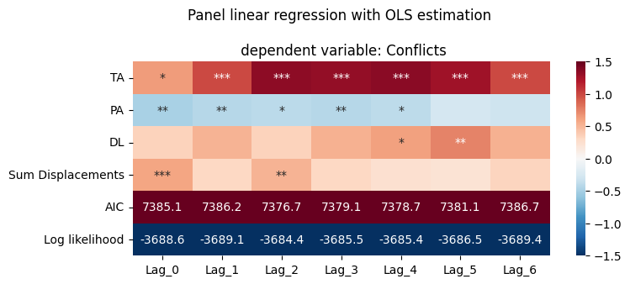
LINEAR MODEL 1b
Add the number of displacements arriving to the region

Slide 6
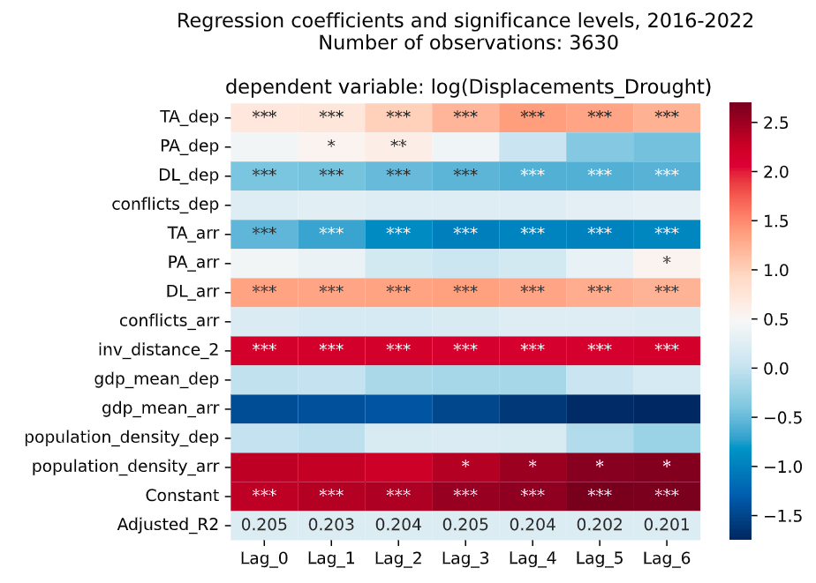
LINEAR MODEL 2
Log (Displacements) ∝
Climate and conflict variables in the departure and arrival regions,
inverse distance^2,
control variables

Slide 7
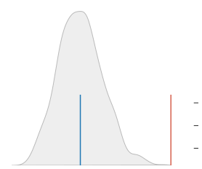
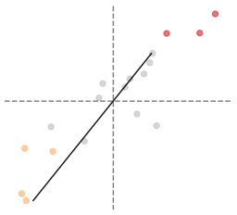
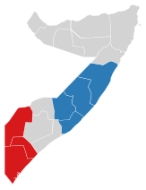
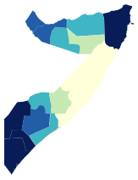
SPATIAL AUTOCORRELATION
Reference Distribution
Moran Local scatterplot
1.5
1.0
0.5
0.0
0.5
1.0
1.5
2.0
1.5
1.0
0.5
0.0
Density
Spatial Lag
0.32, 0.36 0.36, 0.43 0.43, 0.48 0.48, 0.50 0.50, 0.58
HH LL ns
0.6
0.4
0.2
0.0
0.2
0.4
0.6
1.5
1.0
0.5
0.0
0.5
1.0
1.5

Slide 8
MODELS
y = X
y = WX + X
y = WY + WX + X
Linear
SLX
SDM

Slide 9
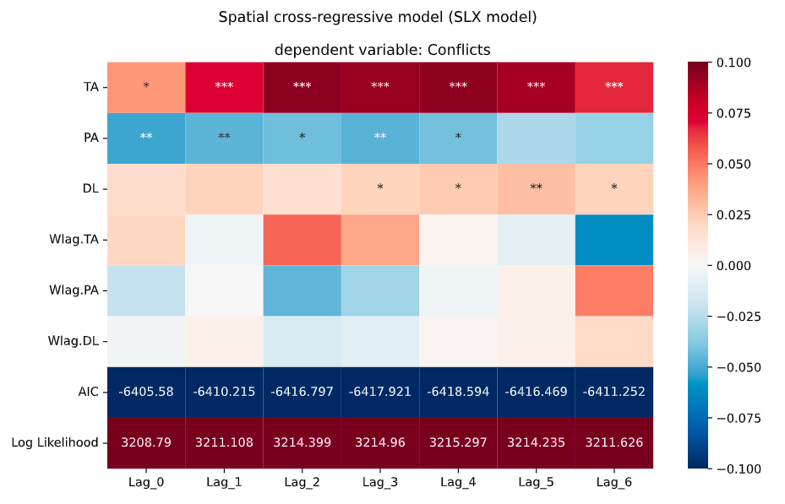
y = βX + Wlag.β WX

Slide 10
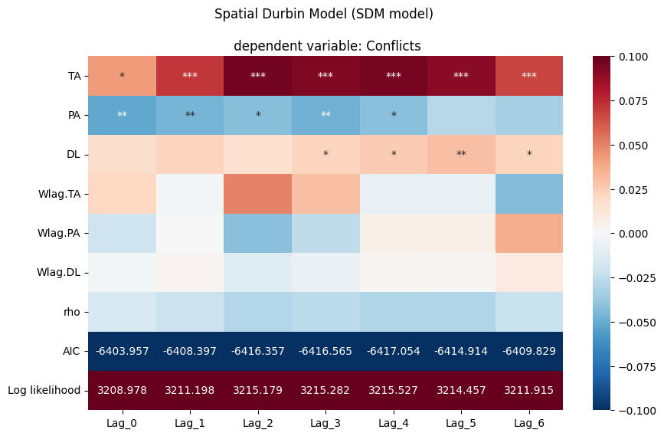
y = βX + Wlag.β WX + ρ WY

Slide 11
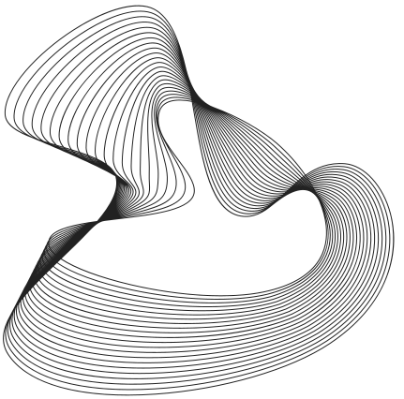
Thanks to the team
Elisa Omodei, Eugenio Valdano, Alberto Antonioni, Daniela Paolotti, Kyriaki Kalimeri, Lorenzo Dall’Amico, Rossano Schifanella

Slide 12

Thank you for your attention
Sara Ghivarello

